Slide 1
FAIR CHANCE HOUSING
KNOW YOUR RIGHTS WHEN APPLYING TO HOUSING WITH A RECORD
Last updated October 2018

Slide 2
INTRODUCTION
Notes:
INTRODUCTION
Welcome to Root & Rebound’s training on Fair Chance Housing!
This presentation will begin with a brief overview of what Fair Chance Housing is, why it is so important, and what you will learn today as you work through the training.

Slide 3
FAIR CHANCE HOUSING
WHAT IS IT?
Fair Chance Housing means that people with criminal records should not have to experience additional barriers to accessing housing because
of their record.
Notes:
WHAT IS IT?
When we say Fair Chance Housing we’re talking about the belief that people with criminal records should not have to experience additional barriers to housing solely because of their record.

Slide 4
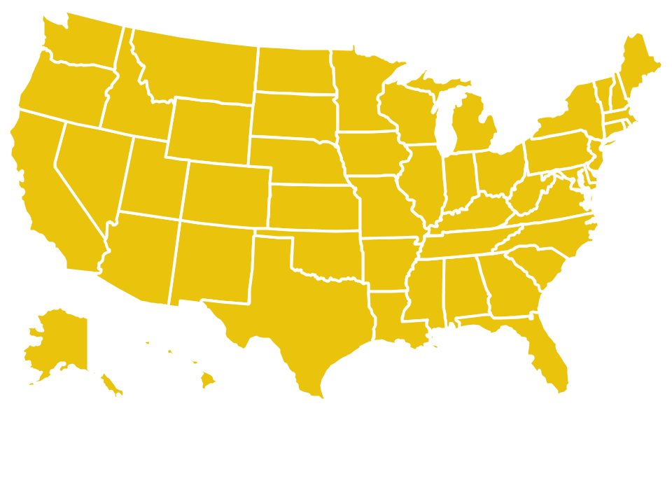
WHY IT’S IMPORTANT
1/3
ALL 50 STATES AND D.C.
AMERICANS HAVE A CRIMINAL RECORD
HAVE A SHORTAGE OF AFFORDABLE HOUSING
Notes:
If you have a criminal record, you are not alone! Today, anywhere between 70 and 100 million, or as many as 1 in 3, people in America have a criminal record.
Among other barriers to reentry, people with records face an increased risk of housing insecurity and homelessness. On a single night in 2017, over 500,000 people were experiencing homelessness in the United States.
40.6 million Americans live at or below the poverty line, but all 50 states and the District of Columbia have a lack of affordable housing. There are only 55 available units for every 100 very low-income households and only 35 available units for every 100 extremely low-income households.
In addition to the scarcity of affordable housing, criminal records create additional barriers to securing safe and secure housing. And people of color are disproportionately represented in both prison and in our homeless population.
The rate of incarceration in state and federal prisons is:
1,608 per 100,000 for African-Americans
856 per 100,000 for Hispanics or Latinos
274 per 100,000 for Whites
41% of those experiencing homelessness - or 224,937 individuals - were African American
22% - 119,419 individuals – were Hispanic or Latino.

Slide 5
OVERVIEW
HOUSING TYPES
THE DIFFERENCE BETWEEN PRIVATE AND FEDERALLY ASSISTED HOUSING
FAIR HOUSING
FEDERAL FAIR HOUSING LAWS & YOUR HOUSING RIGHTS
BACKGROUND CHECKS
CAN A LANDLORD ASK ABOUT YOUR CRIMINAL RECORD?
CHALLENGING ILLEGAL DENIALS
WHAT TO DO IF YOU’RE ILLEGALLY DENIED HOUSING
Notes:
OVERVIEW
In this training, you will learn:
More about the different types of housing that are available, including the difference between private and federally assisted / publicly owned housing, and the three main types of federally assisted housing: the public housing program, the housing choice voucher program, and the project-based section 8 rental assistance program.
About your right not to be discriminated against when you apply to housing, your right to reasonable accommodations if you have a disability, and how your criminal record may impact your ability to get housing in certain federally assisted housing.
How and when a landlord can access information about your background
What you can do if you think information in your background is incorrect or is being used to illegally discriminate against you.
This training follows the same structure – and covers most, but not all, of the information in Root & Rebound’s National Fair Chance Housing Toolkit. We recommend that you download this free Toolkit after this presentation.

Slide 6
OVERVIEW
CHECKLIST OF
ACTION STEPS
ADDITIONAL RESOURCES
Notes:
In addition, at the end of the presentation are slides listing a Checklist of Action Steps you can take as you’re looking for housing or to do if you run into problems because of your record, as well as a list of contact information for other organizations working on these issues in the country. This information is also found in the Toolkit.

Slide 7
DISCLAIMER
This training does not provide legal advice, but rather provides general legal information. No attorney-client relationship is created with Root & Rebound by using any information in this training. If you are looking for legal advice specific to your situation, you should consult and retain your own attorney.
Root & Rebound offers this training template “as-is” and makes no representations or warranties of any kind concerning the toolkit, express, implied, statutory, or otherwise, including, without limitation, warranties of accuracy, completeness, title, marketability, merchantability, fitness for a particular purpose, noninfringement, or the presence or absence of errors, whether or not discoverable.
In particular, Root & Rebound does not make any representations or warranties that this training, or any information in this training , is accurate, complete, or up-to-date, or that it will apply to your circumstances. If you use information from the training, it is your responsibility to make sure that the law has not changed and applies to your particular situation.
Notes:
In addition, at the end of the presentation are slides listing a Checklist of Action Steps you can take as you’re looking for housing or to do if you run into problems because of your record, as well as a list of contact information for other organizations working on these issues in the country. This information is also found in the Toolkit.

Slide 8
APPLYING TO HOUSING WITH A RECORD
A STEP-BY-STEP GUIDE

Slide 9
BEFORE YOU START
STEP ONE: Read the toolkit/watch the training videos!
STEP TWO: Find out what’s on your record.
STEP THREE: Find out what on your record you can get cleaned up.
STEP FOUR: Gather evidence showing rehabilitation and how your life has changed.

Slide 10
APPLYING FOR HOUSING
STEP ONE: Know your rights BEFORE you apply!
STEP TWO: Find out who to apply to (Public Housing Agency for federally assisted housing, or directly to private housing).
STEP THREE: Fill out the housing application.
Notes:
There is a three step approach you should use when applying to housing. First, you should know and understand your rights.
It is important to know your rights BEFORE you apply for housing. That way you know what to look for and when to stand up for yourself. See Section II of the Fair Chance Housing Toolkit for more information on what your rights are as someone with a criminal record applying to housing.
Your rights will depend on whether you’re applying for private or federally assisted housing.
Step two is finding out who to apply to. If you’re applying for any federally assisted housing, you will apply through your local Public Housing Agency. You can find contact information for your local PHA on the Department of Housing and Urban Development’s website, at www.hud.gov/
If you’re applying for private housing, you will apply directly through the landlord or through a real estate agent. Contact the landlord or real estate agent / broker directly for information on how to apply.
Step three is filling out the housing application. Usually, a housing application will include questions about your identity, income, credit, housing and employment history, and, possibly, your criminal record. Landlords CAN ask for you to consent to a background check, or ask you to list your convictions on your application (UNLESS you live in a city or county that has adopted a Fair Chance Housing ordinance).
Landlords CANNOT, however, ask you about arrests that did not lead to convictions, prevent you from applying if you have ever been convicted of a felony, or run a background check on you specifically because of your race, color, religion, sex, national origin, disability status, or familial status.

Slide 11
IF YOU ARE DENIED HOUSING
STEP ONE: Ask why you were denied.
STEP TWO: If you think you were illegally denied housing:
File a complaint to the Department of Housing and Urban Development (HUD) and your state fair housing agency;
Contact a lawyer; and/or
If you were denied federal housing: ask for a review hearing.

Slide 12
DECIDING ON HOUSING
STEP ONE: Decide whether you need short-term/ transitional housing or permanent housing.
STEP TWO: Find out if you qualify for federally assisted housing.
STEP THREE: Look through resources for private housing seekers.

Slide 13
HOUSING TYPES
PRIVATE HOUSING
FEDERALLY ASSISTED HOUSING
Notes:
HOUSING TYPES
There are a lot of different types and forms of housing. For purposes of this training and understanding Fair Chance Housing access and rights for people with criminal records, we will largely focus on the differences between privately owned and federally assisted or publicly owned housing. This is because, as you’ll see in the next section, your rights as a housing-seeker can differ depending on who owns, operates and/or subsidizes the housing. This section will go into more detail on the differences between these two categories of housing, and help you correctly identify which type of housing you may be applying for.

Slide 14
PRIVATE HOUSING
…is owned and operated by a private landlord
(a corporation, non-profit, or individual), NOT the government.
Private housing can be:
>MARKET-RATE >AFFORDABLE
NOT limited to Limited to low low-income applicants low-income applicants
Notes:
PRIVATE HOUSING
Private housing is any housing that is NOT owned and operated by the government.
Private housing can be owned and operated by a corporation, non-profit, or individual. It can take the form of:
Multi-family housing (apartments)
Single-family homes
Homeless or transitional shelters
Senior or other special population housing
Religious housing
Unlike public housing, private housing can be either market-rate or affordable.
Market-rate housing is housing that is available to anyone who can pay the market rate or the listed sales price. The housing is not limited to low-income applicants.
Affordable housing is housing that is limited to low-income applicants and made available at a restricted, affordable price. It is not available to households making more than a set income.

Slide 15
FEDERALLY ASSISTED HOUSING
…is owned, operated, or managed by the federal government
Federally assisted housing can ONLY be:
> AFFORDABLE
Limited to low-income applicants
Notes:
FEDERALLY ASSISTED HOUSING
For purposes of this Toolkit, federally assisted housing is either owned, operated, or managed by the federal government – usually through an agency called the Public Housing Authority (PHA). Like private housing, federally assisted housing can also take many forms, including:
Single family homes,
Multi-family housing (apartments),
Senior housing, and
Housing for people with special needs such as for people with a mental illness.
Unlike private housing, however, all federally assisted housing is only affordable housing available to low-income individuals or households. There is no such thing as market-rate federally assisted housing!

Slide 16
FEDERAL HOUSING PROGRAMS
“FEDERALLY ASSISTED” HOUSING | PRIVATE HOUSING
Public housing program Section 8 voucher program Project-based section 8 housing Section 8 moderate rehabilitation program Section 202 housing (for elderly) Section 811 housing (for individuals with disabilities) Section 221(d)(3) housing (Multi-family Rental Housing for Moderate-Income Families) Section 236 housing (preservation program) Section 514 or 515 (rural housing) | Low Income Tax Credit Housing Shelter Plus Care Supportive Housing program Housing Opportunities for Persons with AIDS (HOPWA)
Notes:
While there are many federal affordable housing programs, there are three main federal assistance programs that are most common and are mentioned a number of times in this training:
Public Housing Program
Section 8 Voucher Program
Project-Based Section 8 Rental Assistance Program
Section I of the Toolkit has more information on these three federally assisted housing types, as well as links to each of the programs listed.
Determining private or federally assisted housing
If you are required to go through your local Public Housing Authority (PHA) or city or county to apply for your housing or voucher, then the housing is considered federally assisted housing for purposes of this training. If you are not sure whether you are applying to private or federally assisted housing, ask the listing agent, realtor, property manager, owner, or other contact listed on the housing advertisement.
If you’re applying for one of these affordable housing programs, this chart can also help.

Slide 17
FAIR HOUSING
YOUR RIGHT NOT TO BE DISCRIMINATED AGAINST
REASONABLE ACCOMMODATIONS FOR PEOPLE WITH DISABILITIES
OVERBROAD CRIMINAL RECORD BANS
Notes:
FAIR HOUSING
In this section, you will learn about your rights to not be discriminated against under the Federal Fair Housing Act, as well as how your criminal record may impact your eligibility for private and federally-assisted housing / public housing programs.

Slide 18
NOTE: This training discusses the federal Fair Housing Act and the U.S. Department of Housing and Urban Development’s guidance on the use of criminal records.
!
This is FEDERAL information. It applies to all 50 states and D.C. But keep in mind that your state or local government might have additional protections for people seeking housing! No matter where you live, it is important to check your state and local law.
Notes:
This training discusses the federal Fair Housing Act and HUD Guidance on the use of criminal records. While these sources form the foundation for your federal fair housing rights and eligibility, no matter where you live, it is important to also look at your state’s fair housing law and any local laws and policies that may affect your access to housing.

Slide 19
KNOW YOUR RIGHTS!
Under the federal Fair Housing Act, you have the right NOT to be discriminated against when you apply for housing based on the following protected classes:
Race
Color
National origin
Religion
Sex
Disability
Family status (e.g., having children)
Notes:
The Fair Housing Act (FHA) is a federal law that applies to the entire country, regardless of where you live, and applies to both private and federally-assisted or publicly owned housing. It is the main law governing housing discrimination in the United States.
The FHA prohibits discrimination in renting, buying, or securing financing for housing based on your membership in any of the seven “protected classes.”
Discrimination based on any of the above protected classes is illegal as long as it is not necessary to serve a “substantial, legitimate, nondiscriminatory interest.”
CRIMINAL HISTORY is not one of the protected classes
NOTE the Toolkit lists a number of situations illustrating illegal discrimination under the FHA.
NOTE the Toolkit also explains a few limited types of housing the FHA generally does not apply to:
Private multi-family apartment buildings with fewer than 5 units when one of those units is occupied by the owner of the building;
Private single-family housing that is sold or rented without the use of a broker;
Private religious organizations that lease apartments for a non-commercial purpose and limit the apartment’s occupancy to members of the organization’s religion;
This exception is strictly limited to religion. A religious organization still can't discriminate based on race, color, or national origin!
A private club that is leasing apartments for a non-commercial purpose and seeks to limit occupancy to the club’s members; or
Private or federally assisted senior housing that fits the rules of 55 years of age and older, or 62 years of age and older communities, or those that participate in a federal, state, or local senior housing program

Slide 20
NOTE on DISABILITY
1 of the 7 federal protected classes
Disability includes:
Physical disabilities like deafness, blindness, mobility limitations
Mental & intellectual disabilities
Past drug or alcohol addiction
Current alcoholism
Notes:
One of the seven protected classes covered by the FHA is disability. It is illegal for a landlord to deny you housing because of a disability.
We specifically highlight this because in addition to physical or mental disabilities – such as deafness, blindness, mobility limitations, intellectual disability – past drug or alcohol addiction, as well as current alcoholism, are also considered disabilities under federal law.
You cannot be denied housing because of past addiction or current alcoholism. Housing providers and landlords can’t even ask about past drug or alcohol abuse. But a landlord can deny you housing if you are currently using or selling illegal drugs.

Slide 21
KNOW YOUR RIGHTS!
Reasonable Accommodation:
A change in rule or practice necessary to allow person with a disability equal opportunity to use & enjoy housing
Landlords are required to provide you with a reasonable accommodation if requested
Must be reasonable AND necessary
Notes:
KNOW YOUR RIGHTS! DISABILITY + REASONABLE ACCOMMODATIONS.
Not only can a landlord not deny you housing because of a disability, but landlords are also required to provide you with reasonable accommodations, if requested. A reasonable accommodation is a change in a rule, policy, practice or service that may be necessary to allow a person with a disability the equal opportunity to use and enjoy a dwelling. A reasonable accommodation must be granted when the accommodation is reasonable + necessary.
Some common examples of reasonable accommodations include permission to use a service animal, to mail payment (instead of delivering it in-person), or request to have a parking space large enough for wheelchair access.
REASONABLE ACCOMMODATION EXAMPLE 1. If you have a substance abuse disability, the housing provider may have to accommodate some behaviors that often accompany recovery or alcoholism, like permitting smoking outdoors in an otherwise smoke-free complex.
REASONABLE ACCOMMODATION EXAMPLE 2. If a landlord has a criminal record screening policy and denies you because of a prior drug- or alcohol-related conviction AND you have undergone related drug or alcohol treatment and no longer suffer from that addiction/disability, you should ask for an exception (the reasonable accommodation) to their screening policy.

Slide 22
HUD GUIDANCE
In 2016 HUD issued guidance on how FHA applies to use of criminal history.
It explains how criminal history should and should not be used by landlords when deciding whether to approve housing applications.
Notes:
HUD GUIDANCE
In 2016, the U.S. Department of Housing and Urban Development (HUD) issued specific guidance on how the Federal Housing Act (FHA) applies to the use of criminal history by housing providers and those involved in real-estate transactions. This Guidance doesn’t change the FHA, but rather helps explain the appropriate use of criminal records in the sale, rental and financing of housing.

Slide 23
KNOW YOUR RIGHTS!
According to the FHA & HUD Guidance, a landlord can’t:
Deny you housing based only on an arrest record
Deny you housing because of a criminal conviction or specific type of criminal conviction without taking into account when the conviction occurred, what the underlying conduct entailed, or what you have done to improve your life since
Treat applicants with criminal records differently
Notes:
KNOW YOUR RIGHTS!
According to the HUD Guidance:
A housing provider cannot deny you housing solely on the basis of an arrest or arrests not resulting in conviction.
No blanket bans on persons who have been previously arrested.
No one can refuse to rent or sell to you solely on the basis of a criminal conviction “no matter when the conviction occurred, what the underlying conduct entailed, or what the convicted person has done since then.”
No blanket bans on persons who have a criminal conviction.
You cannot be denied housing solely because of a specific type of criminal unless the ban serves “a substantial, legitimate, and nondiscriminatory interest.”
Housing providers should take into consideration how much time has passed since the conviction(s) and/or the nature or seriousness of the crime.
The same standards for screening you should apply to all applicants equally.
Example. If they run a background check on you, the must run a background check on all other applicants.

Slide 24
FEDERALLY ASSISTED HOUSING LEGALLY REQUIRED BANS
CONVICTION or ACTIVITY | BANNED FROM | FOR HOW LONG
CONVICTED of methamphetamine production on federally assisted property | Public housing Section 8 Housing Choice Voucher program Section 8 Moderate Rehab program | LIFETIME
CONVICTED of sex offense requiring lifetime registration | All federally assisted housing | LIFETIME
PAST EVICTION from federally assisted property due to drug-related activity | Public housing Section 8 Housing Choice Voucher program Section 8 Moderate Rehab program | 3 YEARS
Currently USING illegal drugs | All federally assisted housing | As long as you’re currently using + ”reasonable time” after illegal drug use
Notes:
While the general rule is that a landlord should not blanketly deny you housing based on your criminal or arrest record, in certain cases, and ONLY in FEDERALLY ASSISTED HOUSING, it is legal and actually required for a landlord to deny you housing if you fall under any of these four categories.
These are the only four situations in which your criminal record will automatically disqualify you.
More specifics in Toolkit Section II: Fair Housing in the Toolkit

Slide 25
ALL HOUSING OTHER LEGAL GROUNDS FOR DENIAL
Drug-related criminal activity
Violent criminal activity
Threat to health, safety or peace of other residents, the owner or public housing agency employees
Private landlord should + federally assisted landlord MUST consider mitigating information & proof of your rehabilitation
Notes:
Even if you don’t fall under any of the four mandatory bans described above, it is still possible that you can be legally denied housing because of:
Drug-related criminal activity,
Violent criminal activity, and/or
Activity that currently poses a threat to the health, safety or peace of other residents, the owner, or public housing agency employees
These broader categories of legal denial allow the PHA or private owner to consider various information when deciding whether to provide you with housing, including:
Past convictions, and
Only if you’re applying to public housing, information from a drug treatment facility you attended if they have reason to believe you’re currently using illegal drugs.
According to the HUD Guidance, it is recommended that private owners and required that PHAs consider mitigating information and proof of your rehabilitation before denying you housing on these grounds. More on mitigating information and proof of rehabilitation later – Challenging Housing Denial; and in Section IV of Toolkit

Slide 26
ILLEGAL DENIALS
BLANKET BANS
Arrest history
Criminal record
Specific convictions
without considering the specific facts of your situation
DISPARATE IMPACT
Legal reason for denial BUT impacts one race (or other protected class) more than others
CRIME FREE HOUSING PROGRAMS
YOU SHOULD IMMEDIATELY CONTACT A FAIR HOUSING OR LEGAL SERVICES ORGANIZATION NEAR YOU TO REPORT ANY SUCH DENIALS!
Notes:
That is the universe of LEGAL bans based on criminal record history.
Despite the FHA & HUD’s Guidance, some landlords –especially private – may still have illegal blanket bans based on:
Arrest history, criminal record, or specific convictions
Disparate Impact
We’ve already explained that landlords can’t discriminate against applicants of a protected class. However, if a landlord denies housing to people for another reason but the end result is that they are denying housing to people of one race or national origin (or other protected class) more than others, this is called disparate impact discrimination. Even though the landlord may not mean to discriminate because of race, the decision still impacted people of one race more than people of other races.
Because African-Americans and Latinos are disproportionately more likely to have a criminal record than other racial groups, denying housing because of criminal history will impact African-American and Latino housing applicants more than housing applicants of other races, and can be illegal under the FHA for this reason.
Crime Free Housing Programs
Over one thousand local governments and police departments across the country are participating in something called the Crime Free Multi-Housing Program. This is a program in which local police departments (1) train landlords and property managers on how to keep their housing crime free, (2) inspect properties to make sure they are designed to prevent crime, and (3) train the people living on the property to prevent crime. Once a property has followed these three steps, it is certified crime free under the program. Some cities and towns require housing providers to become certified as crime free. In other cities and towns, housing providers may choose to become certified.
When police departments train landlords and property managers as part of this program, they talk about how to screen people who apply for housing. Some police departments give landlords and property managers incorrect information that leads to illegal screening practices. BE AWARE that if your city or town participates in this program, you might be illegally discriminated against when you apply to housing!

Slide 27
BACKGROUND lCHECKS
SOURCES OF CRIMINAL RECORD INFORMATION
Notes:
Whenever you apply for housing, the housing provider or landlord can run a background check on you. A landlord can use a number of different sources to access your background information. This background information can include information about your identity, your income, your credit, your housing and employment history, and your criminal record. Where the landlord can get information about your background from depends on what type of housing you are applying for.

Slide 28
SOURCES of CRIMINAL RECORD INFO
All landlords – both FEDERALLY ASSISTED & PRIVATE – can get your background information from:
Your housing application
Private background check or tenant screening companies
Public court records
The Internet
Notes:
All landlords (including landlords for both private and federally assisted housing) can access information about your background from the following sources:
Your housing application
Private background check companies (also called a tenant screening companies)
Public court records
The internet.

Slide 29
SOURCES of CRIMINAL RECORD INFO
Only PHAs can also get your information from:
The National Crime Information Center
State and local police departments & other law enforcement agencies
Other PHAs
ONLY for Public Housing - drug treatment facilities*
*only to ask about reason to believe you’re currently using illegal drugs
Notes:
Only PHAs – when you’re apply for publicly-owned housing or federally-assisted housing programs – can access your background information from the following sources:
The National Crime Information Center
State and local police departments and other law enforcement agencies
Other PHAs
Drug treatment facilities.
If you apply for any of the three main federally assisted housing programs discussed above —public housing, the section 8 voucher program, OR the project-based section 8 rental assistance program—you will apply directly to the PHA. Only the PHA can access your background information from these sources. A private landlord who owns housing that is offered through either the section 8 voucher program or the section 8 rental assistance program cannot access this information. EXCEPTION: Although owners of units in the project-based section 8 rental assistance program cannot access these records directly, they can ask the PHA for information about your criminal record.

Slide 30
FAIR CHANCE HOUSING ORDINANCES
Ban the Box: cannot ask about criminal record on a housing application
If you live in:
City of Newark, NJ
City of Richmond, CA
City & County of San Francisco, CA
District of Columbia
Anti-Discrimination: criminal record added as protected class
If you live in:
City of Champaign, IL*
City of Seattle, WA*
City of Urbana, IL
*some exceptions apply for certain convictions
Notes:
In most parts of the country, a landlord can and likely will ask you about your criminal record when you apply for housing.
EXCEPTIONS. Some cities and counties have recently adopted Fair Chance Housing Ordinances which prohibit landlords from asking about your criminal record on a housing application. Be sure to check your city or county’s laws and ordinances.
As of the writing of this Toolkit, the following cities and counties have adopted Fair Chance Housing Ordinances:
Ban the Box
City & County of San Francisco, CA (only applies to housing receiving public funds)
City of Richmond, CA (only applies to affordable housing)
District of Columbia
City of Newark, NJ
Anti-Discrimination
City of Champaign, IL (Exceptions)
City of Seattle, WA (Exception)
City of Urbana, IL

Slide 31
KNOW YOUR RIGHTS!
If your city or county does NOT have an ordinance prohibiting landlords from asking about your criminal record when you apply for housing…
You can be asked about your criminal record on your housing application.
The landlord MUST ask EVERYONE equally about their criminal record. For example, they can’t only ask applicants of a certain race or sex or other protected category.
Notes:
Although a landlord can ask you about your criminal record when you apply for housing they must ask everyone equally. If you think you are being asked about your criminal record because of your race, color, national origin, religion, sex, disability, or family status, you should file a complaint.
ACTION STEPS
When a housing application asks about your criminal record, you should be honest.
Before you submit your application, you should also gather proof of mitigating evidence and/or proof of rehabilitation. This includes any extra information or evidence that explains that the offense or conduct was not as negative as it seems; and information or evidence that you have changed and improved since the time of your criminal offense or conduct.
See Toolkit section “REVIEW HEARING for FEDERALLY-ASSISTED OR PUBLICLY-OWNED HOUSING” for more on what information can be proof of mitigating evidence or proof of rehabilitation.

Slide 32
KNOW YOUR RIGHTS!
If you are denied housing because of information in your background check, you have a right to:
Know WHY your housing application was denied
The name, address, & telephone number of the company that did the check
Ask for a FREE copy of your background check from the company
Correct any errors with BOTH the landlord & the company
Notes:
When a landlord uses a tenant screening company to run a background check on you, the Fair Credit Reporting Act (FCRA) applies and gives you a number of rights associated with the background check process.
KNOW YOUR RIGHTS! Right to Notice
First, a landlord must inform you that they are running a background check.
If a landlord denies your housing application because of information in your background check, the landlord must:
Tell you why your housing application was denied;
Give you the name, address, and telephone number of the company that did the background check; and
Tell you that you have a right to ask for a free copy of the background check from the company.
*You have 60 days to request the copy
KNOW YOUR RIGHTS! Right to Request a Copy
If your housing application is denied because of information in your background check, you have the right to request a free copy of your background check from the company that the landlord used. Once the landlord notifies you that your application was denied, you have 60 days to request a copy in writing from the company.
KNOW YOUR RIGHTS! Right to Correct
The tenant screening company must make sure that the information in your background check is accurate. If you think the information in your report is wrong, you should:
Tell the company
If you report incorrect information in your background check to the company, they must investigate to make sure the information is correct. If it is incorrect, they have 30 days to either remove or correct the information in your background check.
Tell the landlord
If you think your housing application was denied because of incorrect information in your background check, tell the landlord that the information was incorrect and that you have reported it to the company. If you are applying to federally assisted housing the PHA must give you a review hearing. More on review hearings below.
In addition to these rights, it is important to know that the landlord can only use information from your background check to make a decision on your housing application and must destroy the information once they have finished using it.

Slide 33
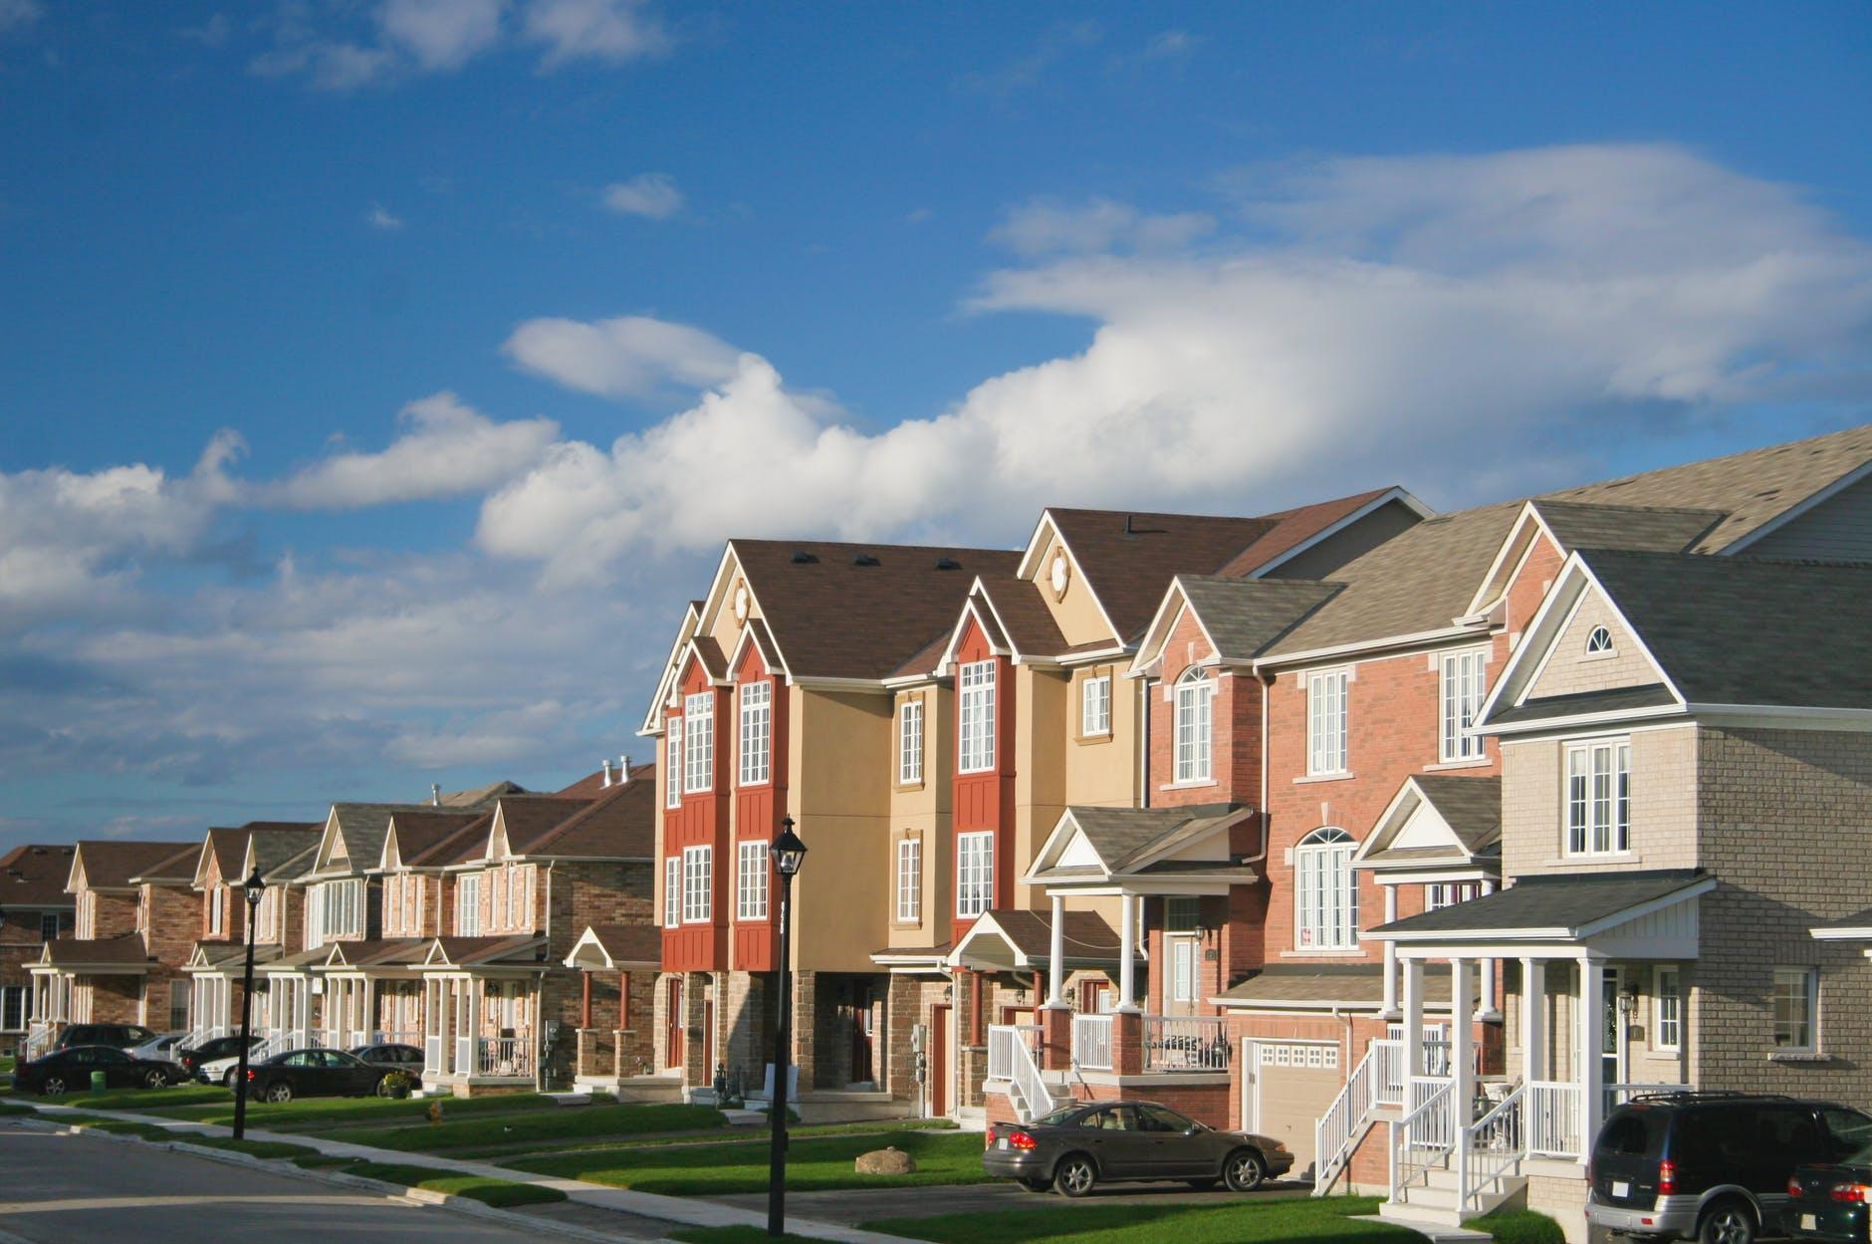
CHALLENGING HOUSING DENIALS
IN FEDERALLY ASSISTED HOUSING
IN PRIVATELY OWNED HOUSING
Notes:
Hopefully this won’t be the case, but if you are denied housing and you have reason to believe it is because of your criminal record history, this section explains who to contact and what you can do.
Again, there are some differences depending on whether you are denied federally assisted vs private housing.

Slide 34
FEDERALLY ASSISTED HOUSING
REVIEW HEARING
Informal (not court) process
You can challenge your denial
With PHA
*Available only if you applied for and were denied federally assisted housing
Notes:
If you applied to federally assisted housing and you believe you were denied housing because of either illegal access to your records, or incorrect or illegal information, you should IMMEDIATELY submit a written request for a review hearing. At a review hearing, you can make corrections to your record, give the PHA evidence of your rehabilitation and other mitigating information, and challenge the denial of your housing application.
What is a Review Hearing?
A review hearing is an informal process (not in a court) where you can challenge your denial of housing with the PHA. The hearing will be conducted by a person (called the “hearing officer”) designated by the PHA, but cannot be conducted by the person, or a subordinate of the person, who denied your application.

Slide 35
KNOW YOUR RIGHTS!
Review Hearing
Right to bring a lawyer (NOT right to be given a lawyer)
Right to be heard before impartial, unbiased officer
Right to state why you should not have been denied, including proof of rehabilitation or mitigating circumstances
Right to explain circumstances of past conviction
Right to ask witness questions
Right to a written decision after hearing
Notes:
How to Prepare for a Review Hearing
Make sure you know why your application was denied! If you don’t know, ask the PHA or owner before the hearing.
Ask the PHA or owner for all documents and information they have about the denial of your housing application
Gather information to show the PHA why you should not have been denied housing. If you were denied housing because of your criminal conviction, this can include proof of rehabilitation or mitigating circumstances, evidence that there was a mistake in the criminal records that the PHA or owner used, or other information that shows why you are not a threat to the health or safety of other residents, PHA staff, or contractors.
EXCEPTION: If your housing is through the Rural Development program, the hearing process is different.

Slide 36
What is Proof of Rehabilitation?
Information & evidence that you have changed & improved since the time of your offense or criminal conduct.
Documents showing you have completed parole, probation, or other supervision
Certificates or diplomas for education you have received
Documentation of completing alcohol or drug treatment programs
Letters of support or recommendations
Notes:
Proof of Rehabilitation
Proof of rehabilitation is information and evidence that you have changed and improved since the time of your criminal offense or conduct.
You can submit:
Certificates or letters from supervising officers or court documents showing that you have completed parole, probation, or other supervision;
Certificates or diplomas for education you have received;
Letters or certificates for completing alcohol or drug treatment programs;
Letters or certificates for completing rehabilitation programs; or
Letters of support or recommendations from employers, educators, volunteer supervisors, former landlords, clergy, or any other non-family member who can speak positively about you.
Legal Action Center has a free online publication that talks you through gathering evidence of rehabilitation too. The link to this is in the Toolkit.

Slide 37
What are Mitigating Circumstances?
Extra information & evidence explaining the offense or conduct is not as negative as it seems, by showing:
A long time has passed since offense or conviction
You were young when you were convicted
You were not involved in the conduct as it seems or there was abuse, coercion or mental illness that led to the conduct
Any other factors that help explain the circumstances & why it should be viewed leniently
Notes:
Proof of Mitigating Factors
Proof of mitigating factors is extra information and evidence that explains that the offense or conduct is not as negative as it seems.
You can submit information that shows:
A long time has passed since your conviction or criminal activity;
You were young when you were convicted;
You were not as involved in the conduct as it seems;
There was physical or emotional abuse, coercion, or mental illness that led to the conviction or criminal activity;
You or a family member had a disability that led to the conviction or criminal activity; or
Any other factors that help explain the circumstances you were in when the crime occurred and why it should be viewed leniently.

Slide 38
PRIVATE HOUSING
No “review hearing” process
BUT
Contact local fair housing or
legal services organization
File complaint with local HUD office or
state fair housing commission
Notes:
If you are denied private housing, there is no process similar to a review hearing where you can challenge your denial. Therefore, if you believe you have been illegally denied private housing, you should contact a fair housing or legal services organization to discuss your situation further and file a complaint either with HUD or your state’s fair housing commission.
See Checklist of ACTION STEPS
Start by contacting your city or county’s housing department or local PHA to ask for referrals to local fair housing and/or legal services organizations in your community, or
See Section V: Additional Resources of this Toolkit for national organizations who may be able to direct you to other resources in your state or community.
AND
File a complaint with your local HUD office or state fair housing commission.
Contact and/or file a complaint with your local HUD Office or state commission designated to investigate fair housing violations.
FIND your local HUD office by visiting https://www.hud.gov/program_offices/fair_housing_equal_opp/
FIND your state’s fair housing commission by visiting https://www.nolo.com/legal-encyclopedia/state-fair-housing-agencies.html

Slide 39
CHECKLIST
Preparing for a review hearing:
Make sure you have written explanation of your denial BEFORE the hearing!
Don’t miss any deadlines!
Ask the PHA or owner for all documents & information related to your housing denial.
Gather information to show the PHA why should not be denied housing.
Proof of rehabilitation
Proof of mitigating evidence
Notes:
For more information, see Toolkit

Slide 40
CHECKLIST
If you think you’ve been illegally denied housing:
Contact a fair housing or legal services organization near you.
Start by contacting your city or county’s housing department or local PHA to ask for referrals to local fair housing and/or legal services organizations in your community.
Find the closest free Legal Aid office near you at www.lsc.gov/what-legal-aid/find-legal-aid
See Section V: Additional Resources of the Fair Chance Housing Toolkit for national organizations who may be able to direct you to other resources in your state or community.
File a complaint with your local HUD office or state fair housing commission.
Find your local HUD office by visiting www.hud.gov/program_offices/fair_housing_equal_opp
Find your state’s fair housing commission by visiting www.nolo.com/legal-encyclopedia/state-fair-housing-agencies
Notes:
For more information, see Toolkit

Slide 41
ADDITIONAL RESOURCES
FOR HOUSING SEEKERS
FOR ADVOCATES

Slide 42
For Housing Seekers
National HIRE Network | hirenetwork.org
Contact at hirenetworkinfo@lac.org or (212) 243-1313 or (202) 544-5478
U.S. Department of Housing and Urban Development
Find your local office at www.hud.gov.program_offices/field_policy_mgt/localoffices
Contact at (202) 708-1112 or TTY (202) 708-1455
Equal Rights Center | equalrightscenter.org/our-programs/fair-housing
Contact at info@equalrightscenter.org or (866) 719-4372
Legal Aid | Find an office near you at www.lsc.gov/what-legal-aid/find-legal-aid
ACLU | Find an office near you at www.aclu.org
American Bar Association | Find free legal help at www.findlegalhelp.org
Notes:
See Toolkit for more detailed information + contact details
The following national resources are good places to start if you’re looking for more information on fair housing - including trust-worth fair housing and free legal services organizations in your community.

Slide 43
For Advocates
Advocacy Resources
National HIRE Network | hirenetwork.org
Contact at hirenetworkinfo@lac.org or (212) 243-
1313 or (202) 544-5478 Shriver Center | www.povertylaw.org
Contact at info@povertylaw.org or (312) 263-3830
Vera Institute | www.vera.org
Contact at contactvera@vera.org or (212) 334-1300
National Housing Law Project | www.nhlp.org
Contact at (415) 546-7000
Litigation Resources
Legal Aid | Find an office near you at www.lsc.gov/what-legal-aid/find-legal-aid
Relman, Dane & Colfax | www.relmanlaw.com
Contact at info@relmanlaw.com or
(202) 728-1888
ACLU | Find an office near you at www.aclu.org
NAACP Legal Defense Fund | www.naacpldf.org
Contact at (212) 965-2200
American Bar Association | Find free legal help at www.findlegalhelp.org
Notes:
See Toolkit for more detailed information + contact details

Slide 44
CHECKLIST
Know & Share!
Download the Toolkit & review its Step-by-Step Guide
Watch the Fair Chance Housing video trainings online at www.rootandrebound.org
Find out if the housing you’re applying for is private or public/federally assisted
If applying for federally assisted housing - request a copy of your local PHA’s eligibility policies
Gather proof of mitigating evidence &/or proof of rehabilitation
If denied housing + a background check was done, request a copy + review for errors
Notes:
For more information, see Toolkit

Slide 45
Because a criminal record should not be a life sentence
For more information
Contact Root & Rebound at
info@rootandrebound.org
(510) 279-2662

